Slide 1
JH ProHealth

Slide 2
Steps
Previous Work
Migration
Notification

Slide 3
Equipment Inventory
External Devices
Server: Heroku + VM
Database: Sequel Pro
Platform: React-native server
Internal Devices
ADE: Android Studio
IOS: XCode
JS: Visual studio Code
Testing: Virtual Machine(Genymotion)

Slide 4
Problems of using Genymotion
Ideal Environment for App
Different Configuration File
Hard Coded
Notes:
1: Virtual machine can set environment for App, but when I ran it in physical device, it was crashed because physical devices do not provide all components that App need.
2: Permission denied and Version conflicts
3: In order to perform the actual scenario, Patient ID, feedback, screen navigation can be hardcoded.

Slide 5
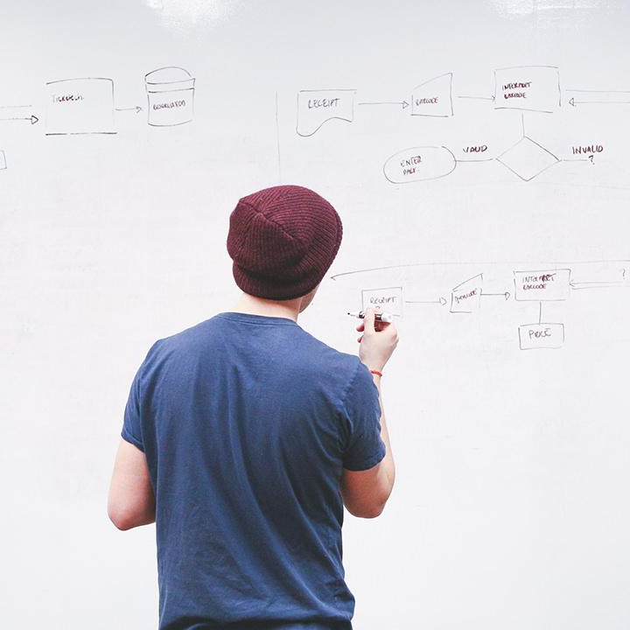
Migration

Slide 6
Solutions
Ideal Environment for App
Write and Include necessary Environment for APK
Rewrite Configuration file and specify the version of each components and initialize methods
Different Configuration File
Initialize start screen, generalize code and store variables in AsyncStorage
Hardcoded
Notes:
1: Virtual machine can set environment for App, but when I ran it in physical device, it was crashed because physical devices do not provide all components that App need.
2: Permission denied and Version conflicts
3: In order to perform the actual scenario, Patient ID, feedback, screen navigation can be hardcoded.

Slide 7
Others
1.
Configured ADB for debugging in real device(Turn off Safe mode)
2.
Set up develop environment and update react-native version from 0.54 to 0.58
3.
Imported external resource, set icon of JH ProHealth.
4.
Developed welcome screen, navigate to correct screen after open App.
Adjust Screen to fit in every mobiles.
5.
Retrieved feedback from server correctly. Assure data belongs to user can be shown.
6.
Developed navigations and screens for patient in different group such as Intervention and control.

Slide 8
Equipment Inventory
External
Server: Heroku + VM
Database: Sequel Pro
Platform: React-native server
Testing : BLU Mobile Phone(Android)
Internal
ADE: Android Studio
IOS: XCode
JS: Visual studio Code

Slide 9

JH ProHealth
After changes, JH ProHealth starts and works successfully.

Slide 10
Notification

Slide 11
Equipment Inventory
External
Server: Heroku + VM
Database: Sequel Pro
Platform: React-native server
Testing : BLU Mobile Phone(Android)
Internal
ADE: Android Studio
IOS: XCode
JS: Visual studio Code
React-Native: 0.58.4

Slide 12
Environment
React-native 0.60
Pubnub( Notification provider)

Slide 13
Pubnub
Token
Server
Request
Notification
App
Feedback & Survey
Token

Slide 14
Barrier
Compatibility between react-native 0.60.5 and 0.58.4

Slide 15
Solutions
Update React Native
Manually change the content of files, based on the project structure of React Native 0.60.
Notification can be easily integrated with JH ProHealth.

Slide 16
Equipment Inventory
External
Server: Heroku + VM
Database: Sequel Pro
Platform: React-native server
Testing : BLU Mobile Phone(Android)
Notification: Pubnub
Internal
ADE: Android Studio
IOS: XCode
JS: Visual studio Code
React-Native: 0.60

Slide 17
THANKS!

